Slide 1
THE BATTLE OF NEIGHBORHOOD
MARYAM ESMALIFALAK

Slide 2
Presentations Content:
Business Problem
Dataset : Allegheny County Property Sale Transactions
Methodology
Collect Inspection Data
Data Analysis
Data preparation and preprocessing
Modeling
Analytical Results

Slide 3
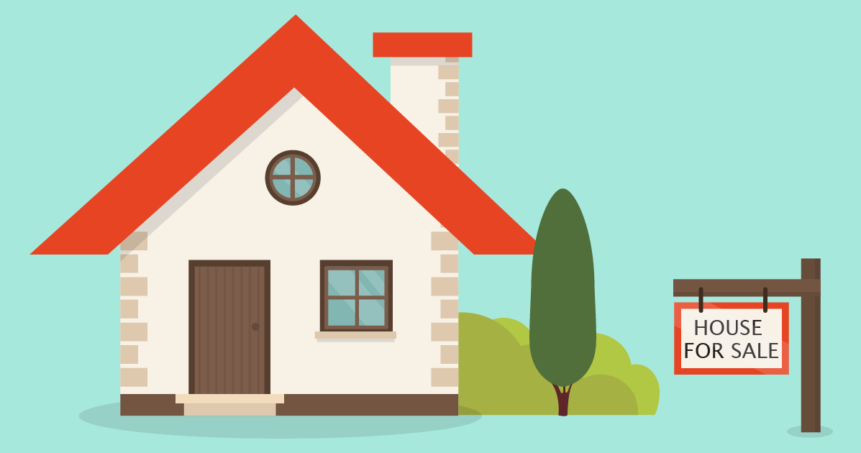
Business Problem
How we can move to a new neighborhood in Pittsburgh PA with similar venues, providing information about the area along with similar house prices that clients can afford.

Slide 4
Dataset: : Allegheny County Property Sale Transactions
This dataset obtained from Allegheny County (Pennsylvania) and the City of Pittsburgh both publish their data through the Western Pennsylvania Regional Data Center.
The Western Pennsylvania Regional Data Center supports key community initiatives by making public information easier to find and use.
The Data Center is managed by the University of Pittsburgh’s Center for Social and Urban Research, and is a partnership of the University, Allegheny County and the City of Pittsburgh. Contains data on all Real Property parcels that have sold since 2013 in Allegheny County, PA.

Slide 5
Methodology

Slide 6
Methodology
Installing and importing all required libraries and uploading the dataset to start the analysis
Analyzing dataset to better understand the variables
Using data mining technique that involves transforming raw data into an understandable format
Producing a descriptive map and models and their relationships between various types of information that are to be stored in a database
Collect Inspection Data
Data Analysis
Data Preparation and Preprocessing
Modeling

Slide 7
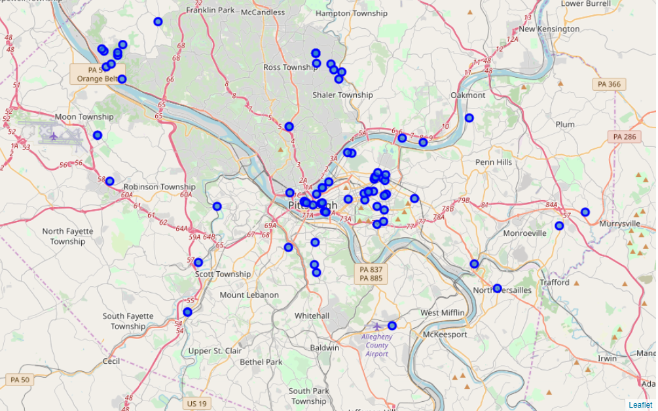
Locating Houses in City of Pittsburgh By Folium

Slide 8
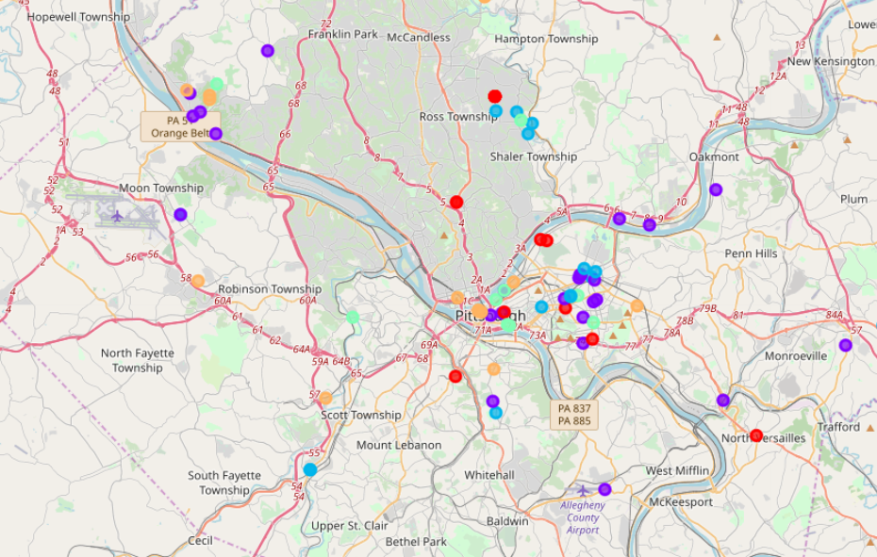
Distribute in 5 Clusters

Slide 9
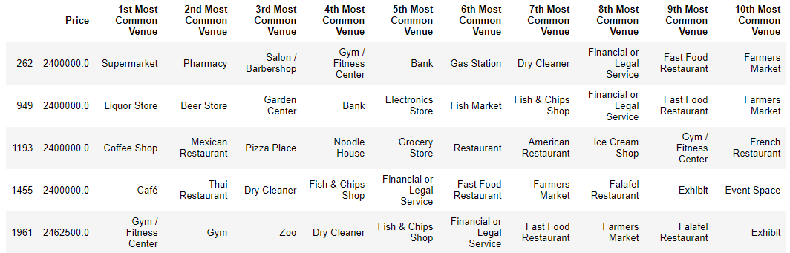
Cluster Samples

Slide 10

Conclusion
In this project we conclude that clusters that have natural amenities are in high demand than the ones that are surrounded with Plazas including restaurants and shopping centers. Cluster 2 and 4 are evident for this fact.
Also this study shows cluster 0 in East Pittsburgh is the best area for profitable purchases as it shows similar characteristics in cluster 2 and 4. One might target underpriced investments in these areas of Pittsburgh in order to make a business affair.

Slide 11
Distribute in 5 Clusters
First bullet point here
Second bullet point here
Third bullet point here
Class | Group 1 | Group 2
Class 1 | 82 | 95
Class 2 | 76 | 88
Class 3 | 84 | 90

